Slide 1
The Paneth Cell

Slide 2
Location
Columnar epithelial cells, found throughout the small intestine
Highest concentration in distal end of small intestine
Reside at the base of the crypts of Lieberkühn
Lifespan of 3 – 30 days, depending on location

Slide 3
Function
Ultrastructural hallmarks of secretory cells (extensive ER; Golgi network)
Function first indicated when discovered that lysozyme was a secretory product

Slide 4
Secretions
Express 2 α-defensins: Human Defensin (HD)5, HD6; lysozyme; secretory phospholipase A2; and RegIIIA
α-defensins are the most abundant of these
Hypothesized to target luminal and surface-associated microbes

Slide 5
Secretions and Innate Immunity
Secreted antimicrobial peptides protect host from enteric pathogens
Shape composition of colonizing microbiota in the intestine
Protection from bacterial translocation of commensal bacteria

Slide 6
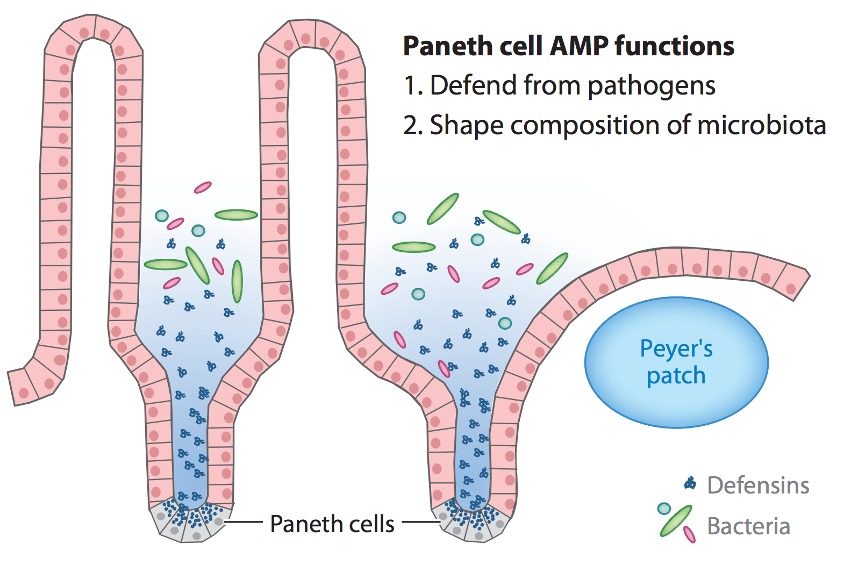
Secretions and Innate Immunity

Slide 7
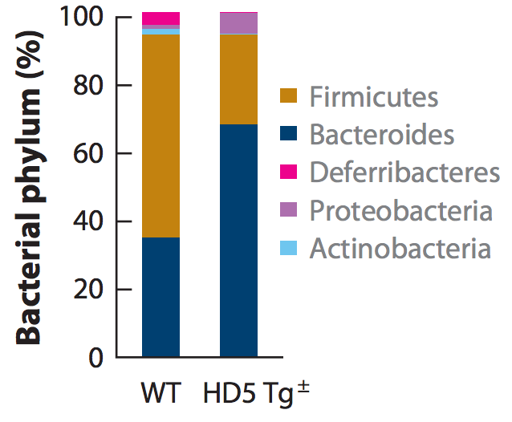
α-defensin Structure and Function
HD5 plays important role in determining composition of colonizing microbiota

Slide 8
α-defensin Structure and Function
HD6 function unknown until recently
Demonstrated to self-assemble into nanofibers and nanonets which surround and trap certain invading pathogens

Slide 9
Paneth Cells in IBD
Crohn’s Disease associated with abnormal bacterial adherence to intestinal surface and abnormal microbiota colonization
Implicate abnormal Paneth cell function
Specifically, reduced α-defensin expression

Slide 10
IFN-γ-dependent Paneth Cell Elimination
IFN-γ production by Th1 during response to T. gondii infection can result in elimination of Paneth cells
Loss of Paneth cell AMPs allows expansion of Enterobacteriaceae
Not seen in germ-free mice: intestinal bacteria are required to potentiate Th1 response and cause Paneth cell elimination

Slide 11
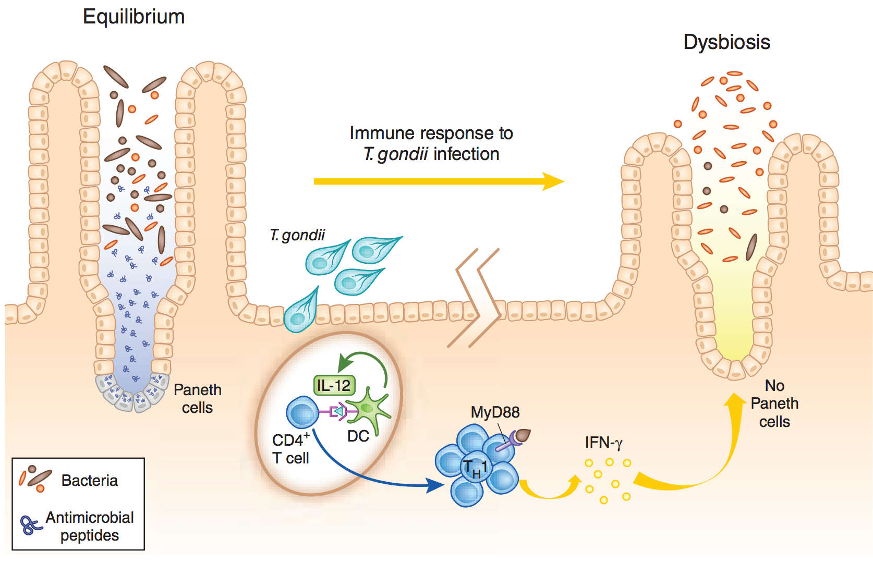
IFN-γ-dependent Paneth Cell Elimination
Notes:
After infection with T. gondii (middle), dendritic cells (DC) that recognize the parasite produce IL-12, which drives the TH1 differentiation of CD4+ lymphocytes in lymphoid tissues. TH1 cells in the intestine are activated to produce abundant IFN-γ via MyD88-dependent intracellular signaling pathways. One consequence of the IFN-γ produced by those TH1 cells (crypt at right) is that the Paneth cells disappear from the base of the crypts and their antimicrobial peptides are no longer produced. The composition of the colonizing microbes shifts as a consequence and Enterobacteriaceae begin to dominate, which
causes the intestinal immunopathology that accompanies infection with T. gondii.

Slide 12
References
Clevers HC, Bevins CL. Paneth cells: maestros of the small intestinal crypts. Annu Rev Physiol. 2013; 75:289-311.
Raetz M, Hwang SH, Wilhelm CL, Kirkland D, Benson A, Sturge CR, Mirpuri J, Vaishnava S, Hou B, Defranco AL, Gilpin CJ, Hooper LV, Yarovinsky F. Parasite-induced TH1 cells and intestinal dysbiosis cooperate in IFN-γ-dependent elimination of Paneth cells. Nat Immunol. 2013 Feb;14(2):136-42. doi: 10.1038/ni.2508.
McSorley SJ, Bevins CL. Paneth cells: targets of friendly fire. Nat Immunol. 2013 Feb;14(2):114-6. doi: 10.1038/ni.2519.
Wilhelm CL, Yarovinsky F. Apicomplexan infections in the gut. Parasite Immunol. 2014 Sep;36(9):409-20. doi: 10.1111/pim.12115.
Buzoni-Gatel D, Schulthess J, Menard LC, Kasper LH. Mucosal defences against orally acquired protozoan parasites, emphasis on Toxoplasma gondii infections. Cell Microbiol. 2006 Apr;8(4):535-44.
Schulthess J, Fourreau D, Darche S, Meresse B, Kasper L, Cerf-Bensussan N, Buzoni-Gatel D. Mucosal immunity in Toxoplasma gondii infection. Parasite. 2008 Sep;15(3):389-95.

